Slide 1
Datasheet Transistor
Untuk mengetahui Parameter Penting Transistor.
Datasheet biasanya diberikan oleh pihak pabrikan.

Slide 2

PARAMETER TRANSISTOR
(Beta)
V

Slide 3
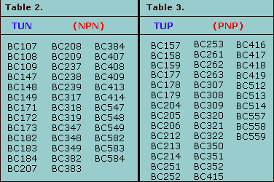
JENIS TRANSISTOR

Slide 4
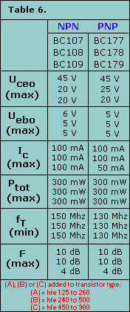
V
V

Slide 5
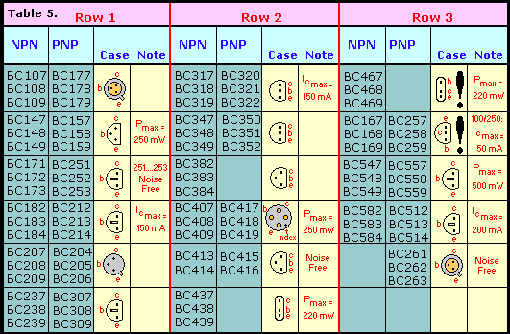
BENTUK TRANSISTOR

Slide 6
KODE TRANSISTOR
Kode mulai huruf B (atau A), contoh BC108, BC478
Huruf pertama : B = silicon, A = germanium (jarang ada ).
Huruf kedua : C = low power audio frequency;
D = high power audio frequency;
F = low power high frequency.
Sisa nomer jenis tertentu
Huruf berikutnya (kalau ada) menunjukkan hfe
A= hfe rendah
B = hfe menengah
C = hfe tinggi

Slide 7
KODE TRANSISTOR
Kode dimulai TIP, misal TIP31A
TIP = pabrik : Texas Instruments Power transistor. Nomer ganjil : NPN,
Nomer genap : PNP.
Terakhir : versi untuk tegangan yang berbeda.
Kode dimulai 2N, misalnya 2N3053
2N identifies the part as a transistor and the rest of the code identifies the particular transistor. There is no obvious logic to the numbering system.

Slide 8
PEMILIHAN TRANSISTOR
The most important properties to look for are the maximum collector current IC and the current gain Hfe.
To make selection easier most suppliers group their transistors in categories determined either by their typical use or maximum power rating.

Slide 9
TRANSISTOR
NPN transistors
Code | Structure | Case style | I_{C} max. | V_{CE} max. | h_{FE} min. | P_{tot} max. | Category (typical use) | Possible substitutes
BC107 | NPN | TO18 | 100mA | 45V | 110 | 300mW | Audio, low power | BC182 BC547
BC108 | NPN | TO18 | 100mA | 20V | 110 | 300mW | General purpose, low power | BC108C BC183 BC548
BC108C | NPN | TO18 | 100mA | 20V | 420 | 600mW | General purpose, low power
BC109 | NPN | TO18 | 200mA | 20V | 200 | 300mW | Audio (low noise), low power | BC184 BC549
2N3053 | NPN | TO39 | 700mA | 40V | 50 | 500mW | General purpose, low power | BFY51
BFY51 | NPN | TO39 | 1A | 30V | 40 | 800mW | General purpose, medium power | BC639
BC639 | NPN | TO92A | 1A | 80V | 40 | 800mW | General purpose, medium power | BFY51
TIP29A | NPN | TO220 | 1A | 60V | 40 | 30W | General purpose, high power
TIP31A | NPN | TO220 | 3A | 60V | 10 | 40W | General purpose, high power | TIP31C TIP41A
TIP31C | NPN | TO220 | 3A | 100V | 10 | 40W | General purpose, high power | TIP31A TIP41A
TIP41A | NPN | TO220 | 6A | 60V | 15 | 65W | General purpose, high power
2N3055 | NPN | TO3 | 15A | 60V | 20 | 117W | General purpose, high power

Slide 10
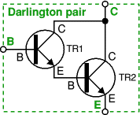
TRANSISTOR DARLINGTON
Kedua transistor disambung seperti tergambar.
Penguatan arus total adalah perkalian antara penguatan kedua transistor.
Gain transistor Darlington bisa mencapai 10000.
Transistor Darlington dijual dalam kemasan seperti transistor biasa dengan tiga kaki (B, C and E).

Slide 11

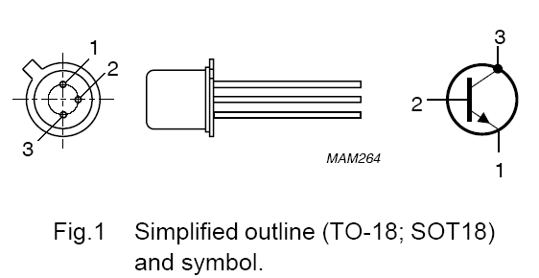
BC108
GP-Low Power
Datasheet BC108

Slide 12
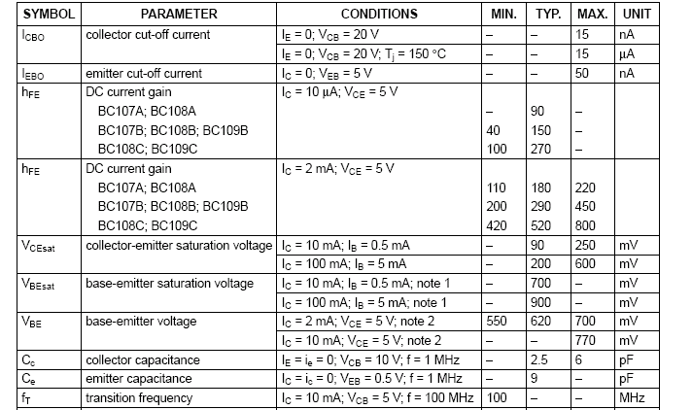
Catatan:
Hfe atau Beta tergantung dari Ic dan Vce

Slide 13
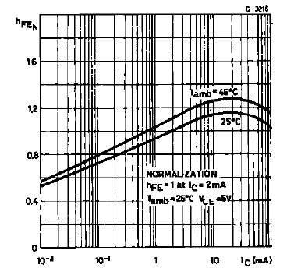
Hfe tidak konstan, tetapi fungsi dari Ic

Slide 14
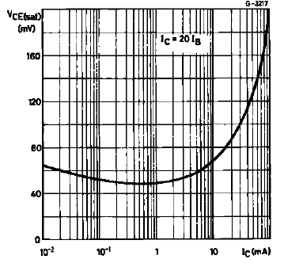
vce juga ditentukan oleh Ic

Slide 15
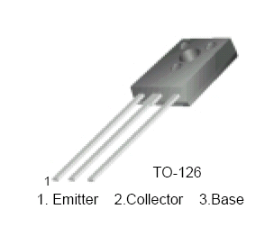
Transistor daya

Slide 16
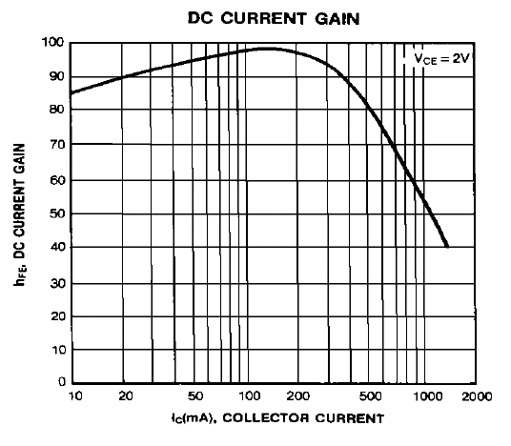

Slide 17
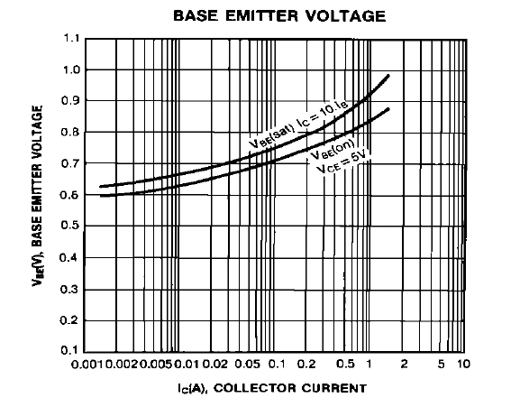
x

